Slide 1
Behavioral Health Market Assessment
Highmark Inc.
4/2/19

Slide 2






Behavioral Health By the Numbers
Prevalence of mental illness is growing in the U.S. with the majority of individuals not receiving treatment leading to increased cost, disability, and catastrophic cases.
High Prevalence of Mental Illness in America
Lack of Treatment
1 in 5 American adults experience a mental illness
60% of adults didn’t receive mental health services in the previous year
50% of youth didn’t receive mental health services in the previous year
One-half of chronic mental illness begins by age 14
Three-quarters by age 24
Creating a Strong Impact
1.1% (2.4 million) living with schizophrenia
2.6% (6.1 million) living with bipolar disorder
6.9% (16 million) living with major depression
18.1% (42 million) living with anxiety disorders
Depression is the leading cause of disability worldwide
Serious mental illness costs the U.S. $193.2 billion in lost earning each year
90% of those who die of suicide have an underlying mental illness. Suicide is the 10th leading cause of death.
Source: https://www.nami.org/learn-more/mental-health-by-the-numbers

Slide 3
Behavioral Health By the Numbers
Stress is most prevalent in the Millennial generation with social determinants of health driving increased stress levels.
How Adults Rank Their Stress
Scale from 1 (little to no stress) to 10 (a great deal of stress)
Emerging Sources of Stress
Percent reporting significant source of stress
/
Source: https://www.apa.org/news/press/releases/stress/2018/stress-gen-z.pdf

Slide 4
Barriers to Getting Care
One out of five adults with a mental illness report that they are not able to receive the treatment they need due to cost, access, awareness or fear of social stigma. This number has not declined since 2011.
Financial Barriers
Among adults with an unmet need for mental health services, cost or insurance coverage limitations were the most common reason.
Mental illness expenditures have grown 38% from 2000 to 2015 with a total of 109B in 2015 (Bureau of Economic Analysis)
Shortage of Mental Health Professionals
The Majority of non-metropolitan counties (65%) do not have a psychiatrist and almost half (47%) do not have a psychologist
66% of PCPs report difficulty referring patients for mental health care
Over three years, 42% increase in patients going to ER for psychiatric services
HMK Footprint Access: BH Providers (non-MD) – 1 provider for every 50,000 members; Psychiatry – 1 provider for every17,500 member
Limited Education and Awareness
Missed opportunities to proactively educate, identify and address mental health disorders
Social Stigma
The perception of mental health illnesses leads to individuals avoiding or distancing themselves from others, all of which contributes to worsening well-being.
Stigma can result in lower prioritization of public resources to combat mental health challenges regardless of the large economic burden (CDC)
SAMHSA - Racial/Ethnic Differences in Mental Health Service Use Among Adults, 2015
American Journal of Preventative Medicine, Geographic Variation in the Supply of Selected Behavioral Health Providers, 2018
http://www.mentalhealthamerica.net/issues/mental-health-america-access-care-data
https://health.usnews.com/health-care/patient-advice/articles/2018-05-25/whats-the-answer-to-the-shortage-of-mental-health-care-providers

Slide 5
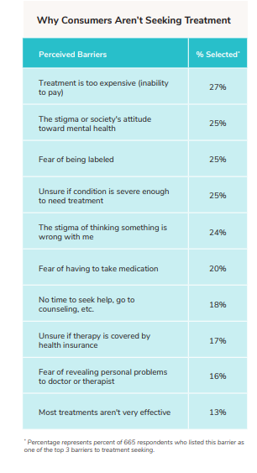
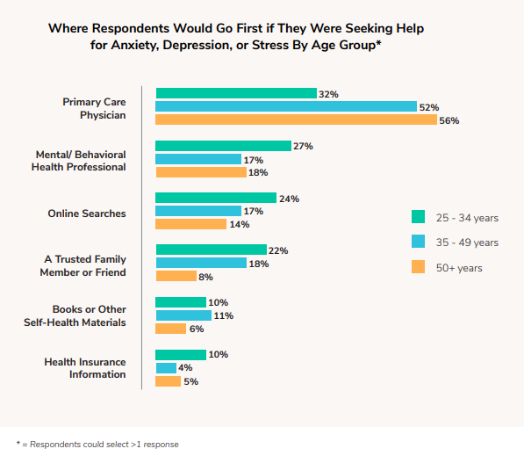
Barriers to Getting Care
Individuals seeking help for behavioral health issues are most likely to turn to their Primary Care Provider first. Primary reasons for not seeking treatment include cost, stigma, and fear.
Source: https://www.ableto.com/wp-content/uploads/2018/10/AbleTo_Barriers-to-Behavioral-Health-Care_WhitePaper.pdf

Slide 6
Value of Early Intervention
Symptoms of behavioral health disorders present in early adolescence. Delays in treatment are frequent and can be detrimental to recovery.
Early Onset of Symptoms
Studies show that often times those who will develop mental heath disorders will show symptoms by age 14 – Imperative for schools, PCPs and behavioral health services to be aligned at educating, identifying and treating
Cases that go undiagnosed can lead to higher rates of school drop outs, homelessness, and suicides
Pervasive Delays in Seeking Treatment
There are pervasive delays in getting treatment: the median across disorders is about 10 years, contributing to greater severity, co-occurrence of mental illnesses, and lower success rates as people age
35-50% of serious cases go untreated in high-income countries
Improved Outcomes of Early Intervention:
Emerging research indicates that intervening early can interrupt the negative course of some mental illnesses and may, in some cases, lessen long-term disability, improve outcomes.
“Intervention is not only critical for preventing or reducing the progress of a mental illness, but for improving a person’s mental and physical health, community participation and socioeconomic outcomes far into the future.”
https://www2.health.vic.gov.au/mental-health/prevention-and-promotion/early-intervention-in-mental-health
Prevalence, Severity, and Unmet Need for Treatment of Mental Disorders, World Health Organization World Mental Health Surveys, June 2004, Journal of the American Medical Association

Slide 7
Physical and Mental Health Connection
Behavioral health conditions co-occur with physical health conditions significantly impact medical spend.
34 million (17%) American adults had comorbid mental and medical conditions in a 12-month period
Substance use disorders are comorbid in roughly 20% of people with depression and 15% of people with anxiety
Compared to people without severe mental illness, people treated for schizophrenia and bipolar disorder are 12 and 20 times more likely to be treated for alcohol abuse and 35 and 42 times more likely to be dependent on illegal drugs
Medical costs for treating patients with chronic medical and comorbid mental health/substance use disorder (MH/SUD) conditions can be 2-3 times the cost of those who don‘t have the comorbid MH/SUD conditions.
Attributed to medical services (more than behavioral) - Opportunity for savings on the medical side through integration of behavioral and medical services.
Clinical trials have suggested there may be cost savings in specific, costly care episodes such as those with comorbid diabetes and depression
BH Conditions Exacerbate
Utilization and Spend up to 3x*
$3,082
$2,269
$1,382
PMPM Cost
$1,407
$505
$740
$451
$193
0
1
2
3+
# of Chronic Conditions
Chronic condition only
No. Chronic + BH
https://www.integration.samhsa.gov/workforce/mental_disorders_and_medical_comorbidity.pdf
http://www.coloradocoalition.org/sites/default/files/2017-01/milliaman-apa-economicimpactofintegratedmedicalbehavioralhealthcare2014.pdf
*Quartet Claims Data

Slide 8
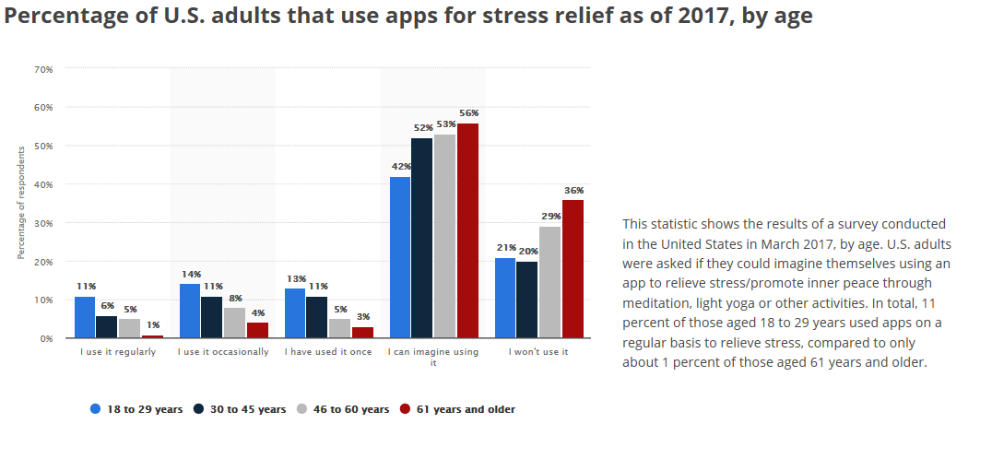
Consumer Demand
Adults and teens are turning to apps and online support tools to manage their health including stress and symptoms of depression.
Percent of U.S. Adults Using Apps for Stress Relief
Adoption of Online Support
Teens and young adults experiencing moderate to severe symptoms of depression are turning to the internet for help.
90% researching mental health issues online
75% accessing other people's health stories through blogs, podcasts, and videos
38% using mobile apps related to well-being
32% connecting with health providers through digital tools (text, video)
33% connected with health peers online, 91% say it was helpful
https://www.statista.com/topics/2099/stress-and-burnout
https://www.prnewswire.com/news-releases/with-depression-and-suicide-rates-on-the-rise-national-survey-reveals-complex-relationship-between-social-media-use-and-mental-well-being-300688913.html

Slide 9
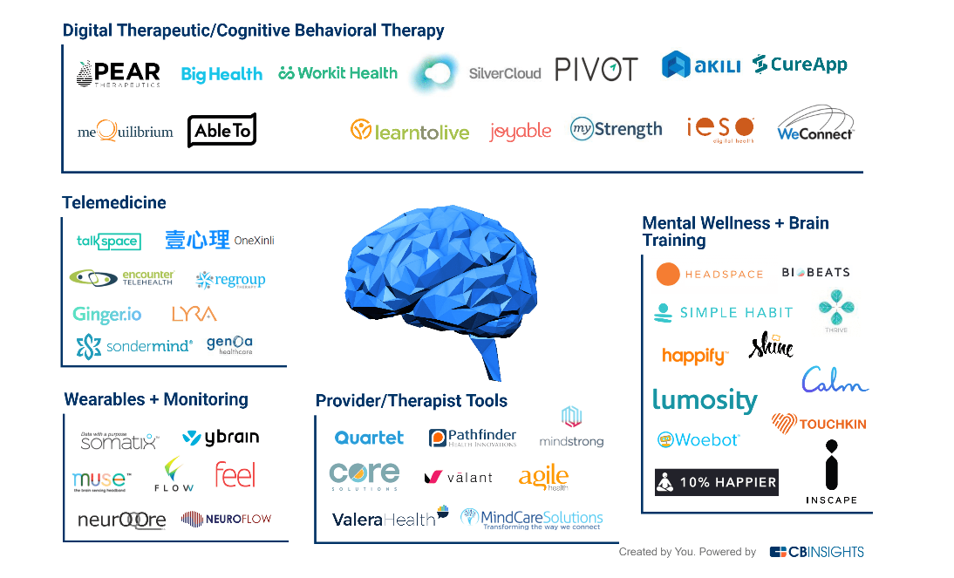
Market Landscape – Vendor Solutions
The market is saturated with a variety of vendor solutions and technology to assist with managing a broad spectrum of mental and behavioral health conditions.
Notes:
Digital Therapeutic/Cognitive Behavioral Therapy: Startups in this category use evidence-based practices to attack specific mental and behavioral health disorders like addiction, ADHD, anxiety, and more. Recently, the FDA approved some digital therapies like a substance abuse treatment from Pear Therapeutics. Akili is seeking similar FDA approval to treat ADHD.
Mental Wellness + Brain Training: These companies are less focused on specific disorders and more focused on holistically improving mental well-being. This includes meditation companies (Headspace, Simple Habit), mood trackers (Woebot), and games to improve cognitive ability or happiness (Lumosity, Happify).
Provider/Therapist Tools: Companies in this category provide tools to help health professionals run their practices more efficiently and better serve patients with mental health disorders. This space includes EMR/billing tools (Valant), mental & behavioral health disorder detection and risk assessment (Mindstrong, Quartet), and care coordination between a patient’s caregivers and doctors (Valera Health).
Wearables + Monitoring: This space includes companies that either develop hardware or analyze data to better understand mental health. This category includes neuromodulation startups that aim to improve brain health (Ybrain, Flow), as well as startups providing guided meditation (Muse) and patient monitoring (Somatix, Feel).
Telemedicine: This category includes startups that provide patients with access to therapists or psychiatrists via their mobile phone or desktop. Companies include Lyra Health, which is the most well-funded startup in this category, as well as Talkspace.

Slide 10
Market Trends
A wide range of innovative trends are emerging in the market to support individuals with behavioral health issues holistically.
Bring Care into the Community
Walmart partners with Beacon Health Options to offer mental health services in-store
Direct to Consumer Services
Talk Space – subscription based text therapy with video chat option; product positioned for teens and couples available
Precision Medicine
Albertson’s pharmacies partner with personalized medicine specialist, Genomind, in a pilot to optimize medication therapy for individuals diagnosed with a mental illness
Holston Medical Group partnered with 2bprecise (Allscripts) to launch a genomics and precision medicine initiative focused on opioid use disorder treatment
Alternative Therapies
Brief, twice-weekly yoga and massage sessions for 12 weeks were associated with a decrease in depression, anxiety, and back and leg pain in pregnant women with depression, a 2012 NCCIH-funded clinical trial showed.
Meta-analysis found that about 50% of patients who got acupuncture had improvement in pain compared with 30% who did not
Mind and Body Connection
“Cigna, with the help of Queen Latifah, Nick Jonas and Ted Danson, is encouraging Americans to take control of their health by getting an annual check-up — and to be open with their doctor about their physical and emotional well-being when they do.” https://www.cigna.com/takecontrol/go/body-mind-connection

Slide 11




Competitive Analysis – National Health Plans
National competitors are leading in the behavioral health space with digital solutions and initiatives to reduce social stigma.
Cigna Total Behavioral Health program includes Happify Health and iPrevail – activities and chat room that focus on resilience, cope with stress, anxiety, depression
Pilot with Annum – digital app with support of health coaches, physicians and therapists that helps members with risk alcohol consumption change behaviors
Offer virtual BH through American Well
Mind Body Connection celebrity campaign
Aetna Resources for Living mobile app includes mood tracking, resilience tips
Leverage MyBrainSolutions (Total Brain) – interactive brain training site to help manage stress and improve cognition
Offer members free access to myStrength – anxiety, depression, substance misuse
EAP administered through Resources for Living, LLC
Case study on the benefits of pharmacogenetics testing
Mental/Behavioral Health virtual visits through Doctor on Demand
Partnership with Happify Health – leveraging for chronic heart condition patients and Medicare
Humana Behavioral Health website with focus on UM, complex case management, after care f/u and integration of medical and behavioral health
BH and EAP solutions through Optum, Live and Work Well program
“Solutions for Caregivers” program – connect with care manage, discounted products
Notes:
"We are continuing to expand and evolve our behavioral health solutions to support the wide and varying mental well-being needs of the people we serve. It's our hope these new digital tools will help empower people to actively engage in their mental health, and make it easier to get support when they need it.“
- Julie McCarter, VP Product Solutions, Cigna

Slide 12



Competitive Analysis – Regional Health Plans
Highmark is on par with regional competitors who are offering behavioral health support through case management, EAP and telemedicine.
Beating the Blues – online cognitive behavior therapy tool
Life Solutions (EAP) – 24/7 support, access to attorneys, financial advisors, etc.
Magee and UPMC Hamot offering an opioid addiction treatment program for pregnant women
Five-year study improve outcomes of patients with IBD and BH conditions through a team or tech-based program
Virtual BH through American Well
Benefits are managed through Magellan Healthcare, Inc. (pre-auth, d/c planning)
Online resources for stress, depression, anxiety
BH provider network managed by Magellan Healthcare, Inc.
Speak to Personal Care Advocate for guidance with depression, stress, anxiety
Notes:
"We are continuing to expand and evolve our behavioral health solutions to support the wide and varying mental well-being needs of the people we serve. It's our hope these new digital tools will help empower people to actively engage in their mental health, and make it easier to get support when they need it.“
- Julie McCarter, VP Product Solutions, Cigna

Slide 13
The Impact to Highmark
A product strategy that targets the highest cost and prevalent behavioral health conditions will drive outcomes and cost savings.
Top Total Spend BH Conditions |  |  |  | Top Prevalent BH Conditions
ETG Base | Total Spend | Rx Spend |  | ETG Base | Claimants | % Membership*
238800 Mood disorder, depressed | $188,033,191 | $31,085,808 |  | 238800 Mood disorder, depressed | 211,684 | 6.83%
271500 Opioid/barbiturate dependence | $71,588,831 | $12,212,811 |  | 239800 Anxiety disorder/ phobia | 201,765 | 6.51%
239800 Anxiety disorder/ phobia | $68,227,580 | $9,221,948 |  | 240600 Other psych/behavior disorder | 105,260 | 3.40%
238900 Mood disorder, bipolar | $68,044,133 | $16,989,596 |  | 271600 Other drug dependence | 91,017 | 2.94%
240100 Attention deficit disorder | $66,458,511 | $45,923,712 |  | 240100 Attention deficit disorder | 87,501 | 2.82%
271600 Other drug dependence | $58,143,741 | $8,258,080 |  | 238900 Mood disorder, bipolar | 27,236 | 0.88%
271400 Alcohol dependence | $57,811,981 | $1,700,421 |  | 271500 Opioid/barbiturate dependence | 14,483 | 0.47%
240600 Other psych/behavior disorder | $45,408,367 | $6,256,488 |  | 271400 Alcohol dependence | 12,163 | 0.39%
239200 Autism spectrum disorders | $38,039,060 | $1,502,943 |  | 239200 Autism spectrum disorders | 10,049 | 0.32%
239300 Psych & schizo disorder | $29,633,208 | $3,797,523 |  | 317100 Cong disorder CNS | 6,366 | 0.21%
317100 Cong disorder CNS | $28,727,063 | $1,049,167 |  | 271200 Acute alcohol intoxication | 5,883 | 0.19%
239700 Eating disorder | $11,946,453 | $254,837 |  | 239700 Eating disorder | 5,103 | 0.16%
271100 Cocaine or amph dep | $7,677,276 | $30,449 |  | 239100 Mental disorder organic/drug | 4,738 | 0.15%
271200 Acute alcohol intoxication | $4,789,384 | $64,693 |  | 239300 Psych & schizo disorder | 4,630 | 0.15%
240000 Psychosexual disorder | $2,881,742 | $1,942,486 |  | 240000 Psychosexual disorder | 4,318 | 0.14%
239100 Mental disorder organic/drug | $2,581,257 | $169,133 |  | 271100 Cocaine or amph dep | 2,061 | 0.07%
239400 Personality disorder | $707,735 | $61,358 |  | 239400 Personality disorder | 887 | 0.03%
Depression
Anxiety Disorder
Substance Use Disorder
Attention Deficit Disorder
Bipolar Disorder
211,684 claimants
$188,033,191 total spend
$31,085,808 Rx spend
201,765 claimants
$68,227,580 total spend
$9,221,948 Rx spend
119,724 claimants
$195,221,830 total spend
$22,201,761 Rx spend
87,501 claimants
$66,458,511 total spend
$45,923,712 Rx spend
27,236 claimants
$68,044,133 total spend
$16,989,596 Rx spend
*3.1 M members (does not include MA)

Slide 14
Behavioral Health Spectrum
The Highmark Behavioral Health Product Strategy spans across the spectrum from keeping members well to optimizing treatment.
Well
Undiagnosed
Diagnosed
Untreated
Diagnosed Suboptimal Treatment
Diagnosed
Optimal Treatment
Keep Well
Identify and Engage in Treatment
Optimize Treatment throughout acute and chronic phases
Depression
Anxiety Disorder
Substance Use Disorder
Attention Deficit Disorder
Bipolar Disorder
Schizophrenia - C2V focus
Child/Adolescent - C2V focus
*C2V focus areas

Slide 15
Current Initiatives and Opportunities
Exists Today
Exists Today/Opportunity to expand
Opportunity/Not in place today
 | Well | Undiagnosed | Depression | Anxiety | Substance Use Disorder | Bipolar | Child and Adolescent | Schizophrenia
Benefit Coverage
Client Levers
Member Support
Provider Support
Blue 365/CAM
Mental Health Benefits (Face to Face/Virtual)
Preventive Care
PCP Copay for Mental Health
Preventive Mental Health Care
Freespira
Virtual Treatment
Peer Recovery Support
Rewards & Challenges*
Well 360 Advisor*
Employee Assistance Program (EAP)
Value Based Benefits
SC RAT/Content
BH Case Manager (Well 360) Support
Daily Steps to Less Stress
Well 360 Focus/Connect Differentiation
SC RAT and
Green Days Data
Medication Adherence
LARK
Member Education Campaign
Mindfulness
(SC Inspirations)
Livongo/MyStrength
LARK
Quartet/Joyable
Freespira
Axial
Integrated BH Case Managers
Value Based Reimbursement
Education on HMK Resources

Slide 16
Problem and Opportunities
High cost of care, inadequate access, and fear of social stigma are leaving members with behavioral health conditions unidentified and untreated in turn leading to increased medical costs.
Cost of Care
Routine and consistent care is not affordable
Opportunities…
Reduce member cost share for behavioral health services (mirror PCP copay structure)
Coverage of Alternative Therapies (med marijuana, acupuncture, herbals)
Identification
Member, Health Plan, Provider are unaware of existing BH issue
Opportunities…
Predictive analytics to identify and engage
Leverage vendor data to identify and monitor (Sharecare, Catapult)
Post-partum depression screenings and provider/health plan integration
Annual preventive visit with BH provider
Inadequate Access
Lack of providers available to treat BH conditions
Opportunities…
Virtual BH through national/local telemedicine partners
Virtual Opioid Treatment
Multi-modal channels for care that can scale nationally– digital tools and support
Integrated PCP/BH care
Strategies to attract AHN BH Providers (sign on bonus, reimbursement for school, etc.)
Competitive Provider Reimbursement
HMK Direct Store Integration
Social Stigma
Perception of behavioral health issues are preventing people from seeking care
Opportunities…
Create awareness of support and coverage
Testimonials (‘All For Her’ campaign for BH)

Slide 17
Next Steps/Recommendations
An opportunity exists to improve the behavioral health of our members, reduce medical cost and increase care coordination. Collaboration and support throughout the Enterprise is essential to drive outcomes.
Product Strategy Areas of Exploration
Cost of Care
Evaluate financial risk of reducing member cost share or offering preventive (free) visits
Explore social determinants of health tie in
Identification
Explore data vendors are providing back to Highmark and the ability to leverage data for member engagement
Explore member journey for additional opportunity identification
Inadequate Access
Increase awareness of virtual behavioral health benefits
Continue virtual opioid RFI process
Explore digital solutions that can be expanded nationally
Enterprise Alignment and Collaboration
Reimbursement structure for mental health providers
AHN strategies to increase access to care (integrated BH case managers)
Marketing/Digital support of campaigns to reduce stigma
Collaboration with Behavioral Health/Clinical Services/C2V teams
Retail stores as an additional access point
Coverage of alternative therapies

Slide 18
References
https://medcitynews.com/2018/11/beacon-mental-health-walmart/
https://www.supermarketnews.com/health-wellness/albertsons-cos-pharmacies-offer-genetic-testing
http://investor.allscripts.com/phoenix.zhtml?c=112727&p=RssLanding&cat=news&id=2226108
Andrew J. Vickers, DPhil (attending research methodologist, Department of Epidemiology and Biostatistics, Memorial Sloan-Kettering Cancer Center, New York, New York
https://nccih.nih.gov/health/massage/massageintroduction.htm
https://health.usnews.com/health-care/patient-advice/articles/2018-05-25/whats-the-answer-to-the-shortage-of-mental-health-care-providers
https://www.beckershospitalreview.com/hospital-physician-relationships/new-patient-wait-times-for-dermatologists-in-15-major-cities.html
*https://www.americanwell.com/tele-behavioral-health-reduces-the-cost-of-mental-illnesses
https://news.aamc.org/press-releases/article/workforce_report_shortage_04112018/
https://www.kff.org/other/state-indicator/mental-health-care-health-professional-shortage-areas-hpsas/
SAMHSA - Racial/Ethnic Differences in Mental Health Service Use Among Adults, 2015
American Journal of Preventative Medicine, Geographic Variation in the Supply of Selected Behavioral Health Providers, 2018
http://www.mentalhealthamerica.net/issues/mental-health-america-access-care-data
https://www.healthcarefinancenews.com/news/cigna-adds-two-tech-companies-its-behavioral-health-program

